Slide 1
Strategies to Support Resiliency and Address Trauma Among Youth
Eileen Hare: DPI Education Consultant
Donna Rifken: Community Care Resources and Programs
Mikki Duran: Appleton Area School District
Sheree Garvey: Appleton Area School District
Notes:
Housekeeping: Bathrooms, schedule
Post it notes – bike rack
Worksheets: Bringing it Home, Action Plan – Sustaining my Professional Learning
Stand

Slide 2
Agenda Overview
Welcome
Trauma’s impacts on the developing brains
DPI resources
Break
Appleton Area School District easy to start activities
Lunch
Networking walk
Tier 1 strategies to strengthen resilience in all of us
“Bring it home” challenge
Break
Tier 2 & 3 strategies for de-escalation
Wrap up and takeaways

Slide 3
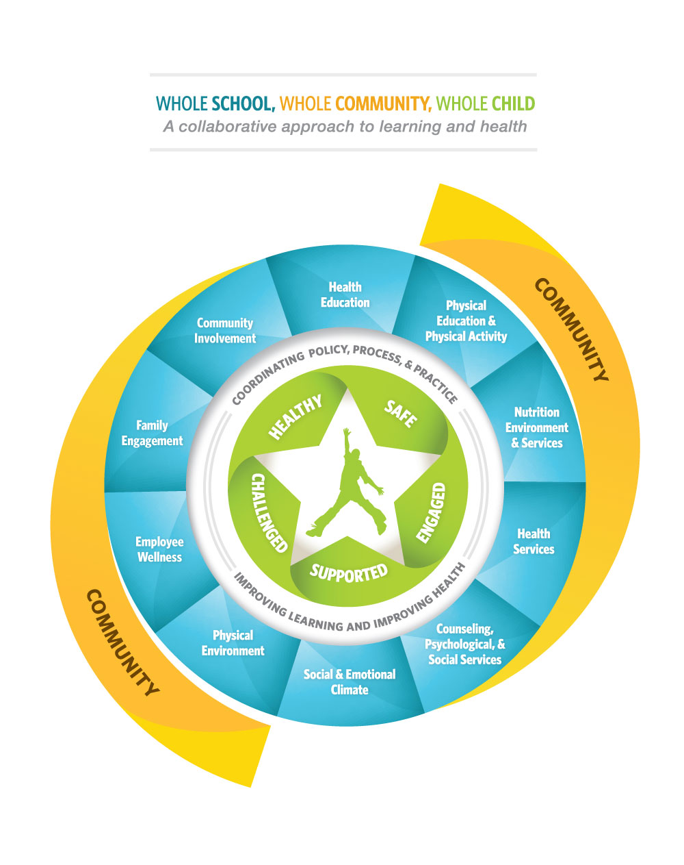
WSCC
Notes:
A collaborative approach to promoting health and academic success – ASCD in collaboration with CDC, released in Spring, 2014
WSCC is designed to promote alignment, integration, and collaboration between education and health and is intended to enhance health outcomes and academic success.
Child as the center
5 tenents/10 components

Slide 4
DPI SSPW Resources
School Mental Health Framework
Trauma-Sensitive Schools Learning Modules
Active Schools: Core 4+

Slide 5
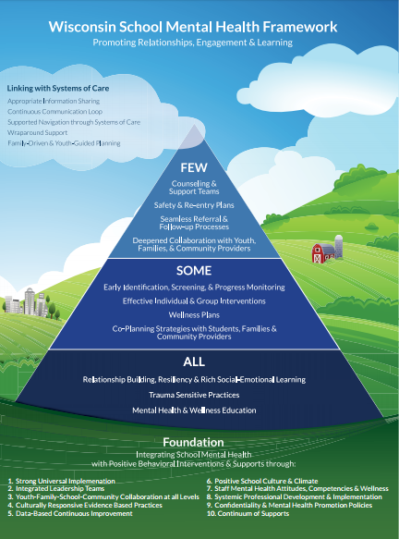
School Mental Health Framework http://dpi.wi.gov/sspw/mental-health Kathryn Bush, DPI: School Psychology Consultant
Notes:
School, family Community Partnerships – mental health Integrating School Mental Health with Multi- level systems of support
STAFF WELLNESS 7. Staff and circle – with pointer.

Slide 6
Trauma-Sensitive Schools Learning Modules http://dpi.wi.gov/sspw/mental-health/trauma/modules Nic Dibble, DPI: School Social Work Consultant
Notes:
The Department of Public Instruction Trauma-Sensitive Schools (TSS) initiative is modeled after the Positive Behavioral Interventions and Supports (PBIS) school improvement process, focusing first on universal practices (Tier 1), followed by strategies for students who need additional support (Tier 2), and intensive interventions for students who require ongoing support (Tier 3).
Almost finished with the Tier 1 modules, 13 of 14 posted in 2018 will create the tier 2/3 learning modules. Long term vision is to create a CADRE of external coaches around the state to support school teams using these learning modules. Model after the WI PBIS network.
232-805

Slide 7
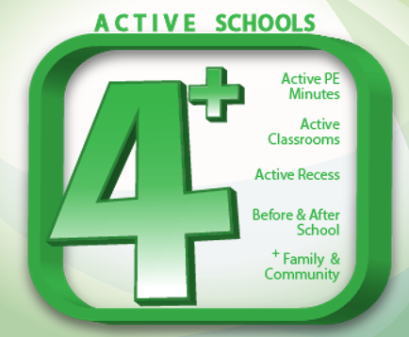
Active Schools: Core 4+ Eileen Hare, DPI: HE/PE/CSH Consultant http://dpi.wi.gov/sspw/physical-education

Slide 8
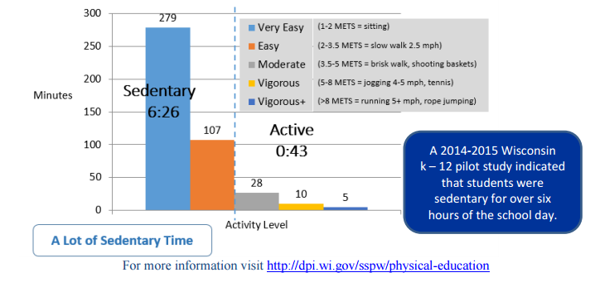
Wisconsin Study

Slide 9
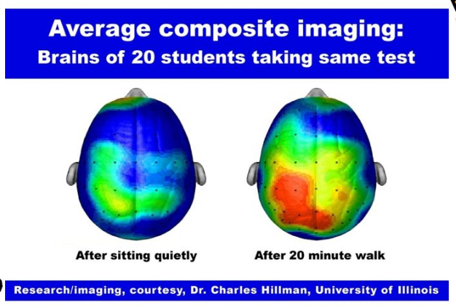
Tier 1 Strategies for Increasing Movement in Schools
Notes:
Pre-adolescent students
Anchors learning when more of the senses are involved to increase the executive function of the frontal lobe Grows new brain cells (neurogenesis) in the learning and memory center (hippocampus)of the brain Gets the brain’s fuel, oxygen and glucose to the brain faster Moves the body in space (spatial awareness) to help the brain see letters and numbers

