Slide 1
Social Emotional Learning
At the
McFarland Elementary Campus

Slide 2
McFarland Elementary Campus
Approximately 500 students
Kindergarten through 2nd Grade
8 classrooms per grade level
Student Services staff
Full-time School Social Worker
Full-time School Psychologist

Slide 3
Universal SEL Practices
Second Step Curriculum
Research based curriculum
Focuses on feelings identification, emotions management, problem solving and bullying prevention
Includes Home Link activities for parents
Incorporated into PBIS Tiers 1 & 2

Slide 4
Implementation
Life Skills Class
Taught by School Psychologist and School Social Worker
Half-hour per 6 day rotation
Taught in the homeroom with classroom teacher present
Parent letter and Home Link activity sent with the completion of each unit

Slide 5
Incorporation
PBIS Tier I
“Rules for Listening” taught in Life Skills are also School Assembly expectations
“Super Kind” Superhero → focus on compassion and empathy
“Super Responsible” Superhero → focus on problem-solving and listen

Slide 6
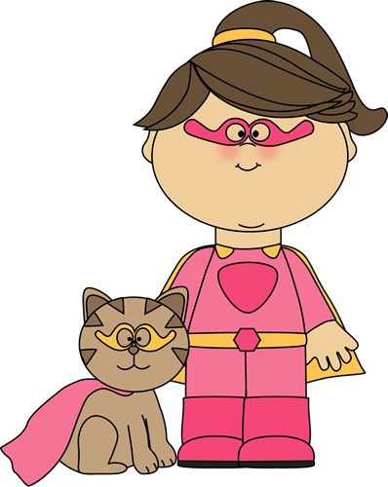
Thinks about helping others and being a good friend
Introducing…
Super Kind
She waits to speak and uses only kind words
Takes care of others
Empathetic = understanding how others feel
Compassionate = showing care for others
Keeps bubble space

Slide 7
Incorporation (cont)
PBIS Tier II
Basic SAIG
Utilizes relevant Second Step lessons and skills
Julia Cook Books
William Mulcahy
Intensive SAIG
Specific Skill Building Groups
Lagging Skills Teacher Survey
Think Social
Zones of Regulation
Incredible 5-point Scale

Slide 8
Intensive SAIG Examples
Stop. Name My Feeling. Calm Down
Belly Breathe
Take 5
Count
Visualize
I’m Feeling...
I should...
1, 2, 3, 4

Slide 9
Parent Connection
Home Link Activities
Parent Letters
Kindergarten Parent Night “Strategies for Challenging Behaviors and Strong Feelings”
Incorporated Second Step emotion management strategies
Information from the Center on the Social and Emotional Foundations for Early Learning
Using videos v. emails to reach parents

Slide 10
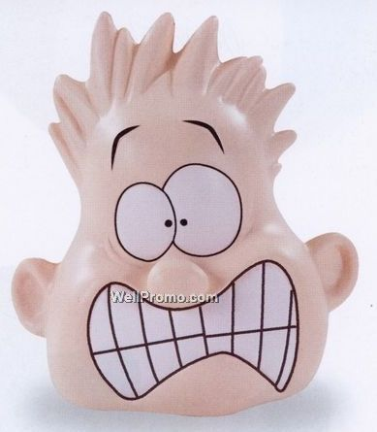
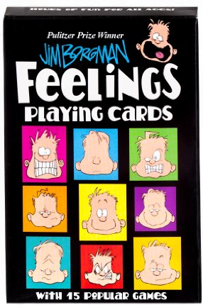
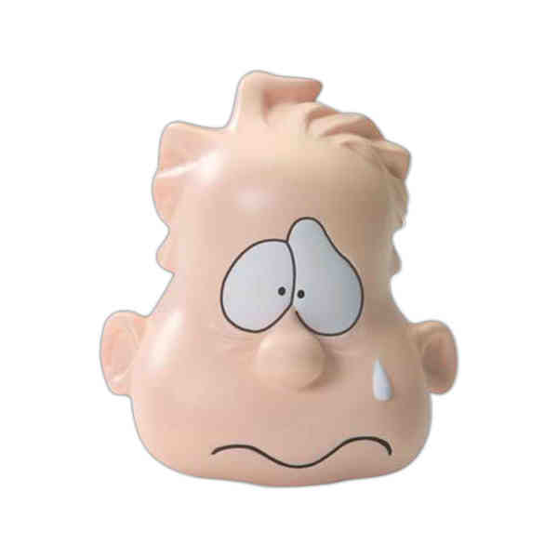
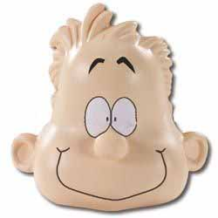
Examples from Kindergarten Family Night
When I feel like this...
I can..
3
2
1

Slide 11
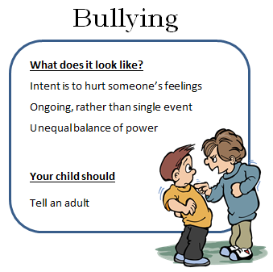
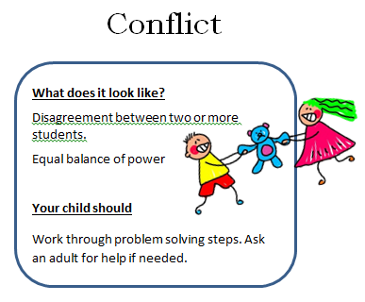
Parent Connection (cont.)
https://www.youtube.com/watch?v=KAvUrcnRfwU&feature=youtu.be

Slide 12
Challenges
Generalization
Student Service Staff time and role

Slide 13
Future Work
Wisconsin School Mental Health Framework
Mindfulness
Generalization
Improved parent communication

