Slide 2
We Have a Problem - The Data
Our school ranks higher than the state and national averages when considering underage alcohol abuse. YRBS survey results showed that to high school sophomores at Osseo-Fairchild High School revealed that students who report having at least one drink of alcohol on one or more days in their lives is 72.4 percent which is much higher than the average Wisconsin high school student number of 65.9 percent
The number of sophomore students at Osseo-Fairchild who reported having their first drink of alcohol, other than a few sips, before the age of 13 is also significantly higher at 32.8 percent compared to the Wisconsin percentage of 14.6 and the national number reported by the CDC of 18.6.
The number for sophomore OF students reporting having a drink of alcohol in the past 30 days is also higher than the Wisconsin average (37.9 compared to 32.7) and the binge drinking number is comparable at 18.4 compared to 17.2.
This is just OF sophomores, and statistics show that as they get older the percentage of students reporting using alcohol will get higher.

Slide 3
Our Idea
Try to get underage drinking to not appear as ‘the norm.’
Currently, we have 108 unique students who participate in athletics throughout the year. This accounts for over 40% of our student population.
That number of unique students involved in extracurriculars increases when we add clubs.
The idea for this group is to focus on and highlight positive peer influences from the athletic and club student population.
We wanted to create positive social norms type campaigns focusing on the student athletes / and club members as ‘the norm’.

Slide 4
Our Goal as Advisors
Highlight students who are making good choices in any way possible (making this behavior seen like the accepted behavior and ‘norm’)
The hope is that if younger students (middle and elementary)are exposed to these students on a regular basis, the Above and Beyond members will become their role models and emulate their behavior.

Slide 5
How did we start
Got administration support
Created a ‘team’
Above and Beyond Advisors (one at elementary, one at middle school and one at high school)
Coaches
Counselors
Administration
Students
Community Input

Slide 6
Student Led
We decided that if this was going to work, the students had to be the lead
Met with a group of students who had attended the ‘Life of an Athlete’ conference in 2014
Came up with a plan

Slide 7
Above and Beyond
The Above and Beyond group is made up of students from Osseo-Fairchild high school who are considered good role models. These students exhibit the characteristics of responsibility, respect, teamwork, involvement, take pride in their efforts on the field and in the classroom, contribute to the community and do it all while remaining substance free. Many of the activities that Above and Beyond are involved in are funded by an AODA grant from the state of Wisconsin.

Slide 8
Student Member Application Process
We had students apply answering simple questions
School Involvement (one requirement is that they are involved in at least one school related activity)
Why would they be a good fit for the group
Why do you think its important to be a good role model
Why do you think its important to stay away from drugs and alcohol
Do you drink alcohol, use any form of tobacco or nicotine device, or use any drugs
Have you ever participated in the above substance use
We got input from the student leadership group and school staff after reviewing the applications

Slide 9
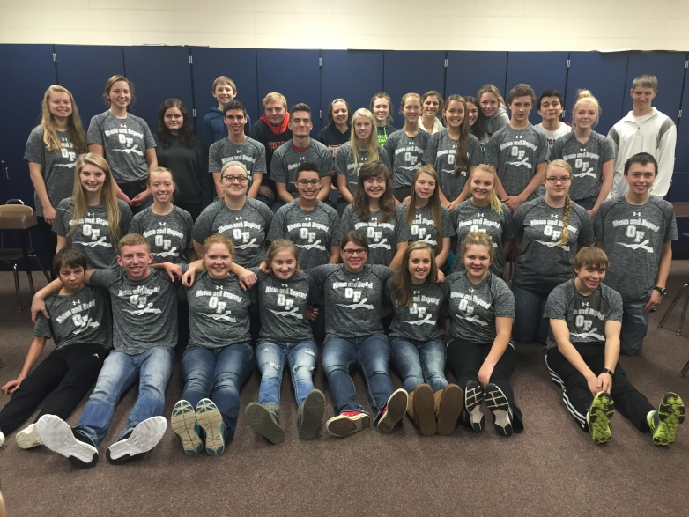
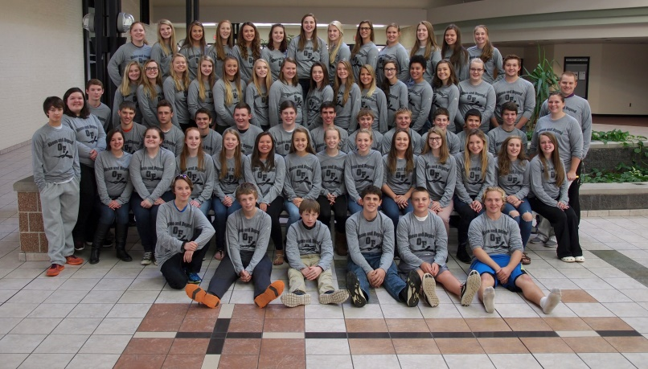
Above and Beyond Student Group
Membership grew from 40 members in 2015 to 65 members in 2016
We had 4 students in 2016 put on ‘probation’ who can prove they are good role models and reapply 2nd semester
We did turn 2 students away after offering to meet with them (they chose not to meet with us)

Slide 10
Above and Beyond Highlight Video

Slide 11
Above and Beyond T-Shirts
Students who were selected as members of the group were given an Above and Beyond t-shirt to be identified as positive substance free role models to other students and the community

Slide 12
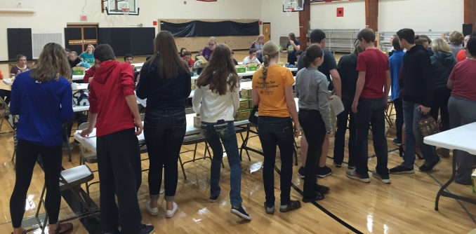
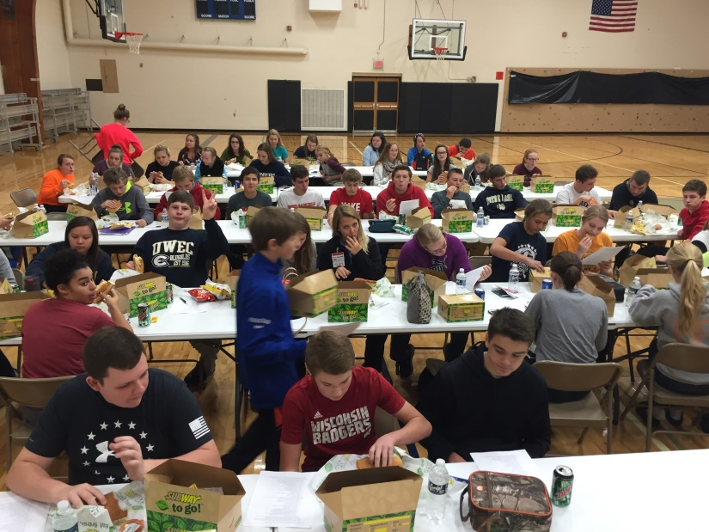
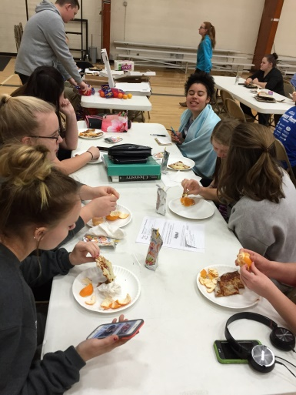
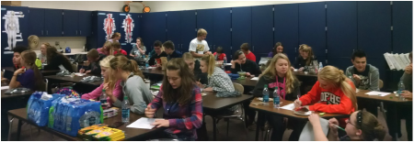
Monthly Meetings
The purpose is to have the students who have similar values bond and interact with each other
Planning for activities
Most students missing this year was 4 - Food is the motivator

Slide 13
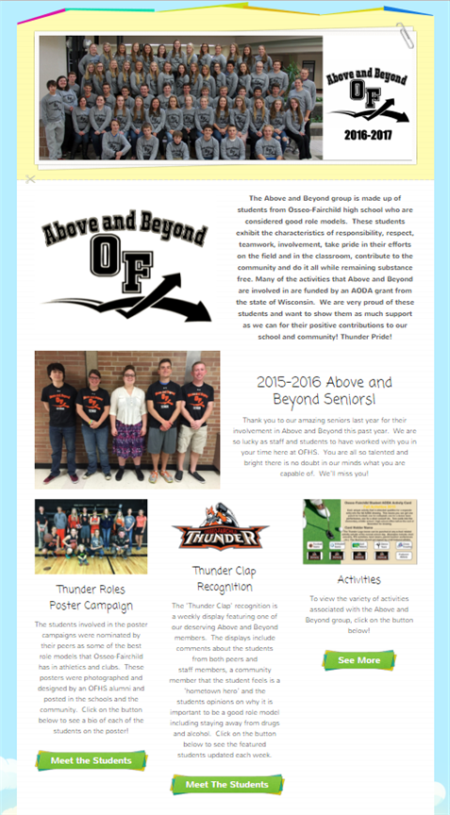
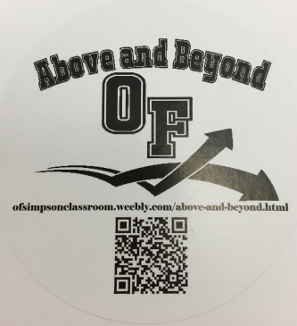
Above and Beyond Website
Website is updated regularly with activities and announcements about Above and Beyond
ofsimpsonclassroom.weebly.com/above-and-beyond.html
QR Code and website on stickers (we put the stickers everywhere – popcorn bags, things that were sent home, student treats etc.)

Slide 14
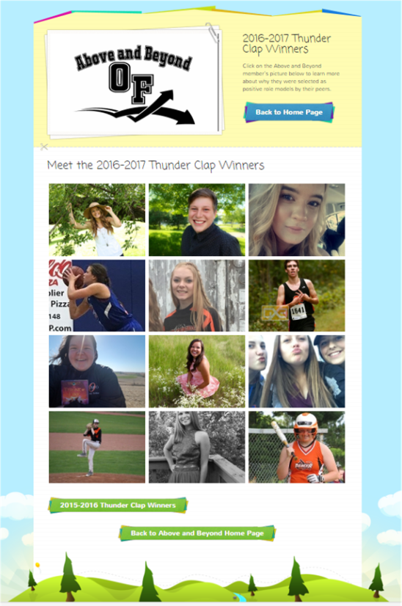
‘Thunder Clap’ Recognition
Thunder Clap Recognition
Bulletin Board
Website Principal Tweet
Normally the website is at 300-400 ‘unique users’ but on Mondays when we update this section we go well above 1,000
Thunder Clap recognition highlight activities the student is involved in, their reason for the importance of being a good role model, their reason for the importance of staying away from drugs and alcohol, positive quotes about the student from peers and staff, hometown heroes and why they are proud of Osseo-Fairchild as a community

Slide 15
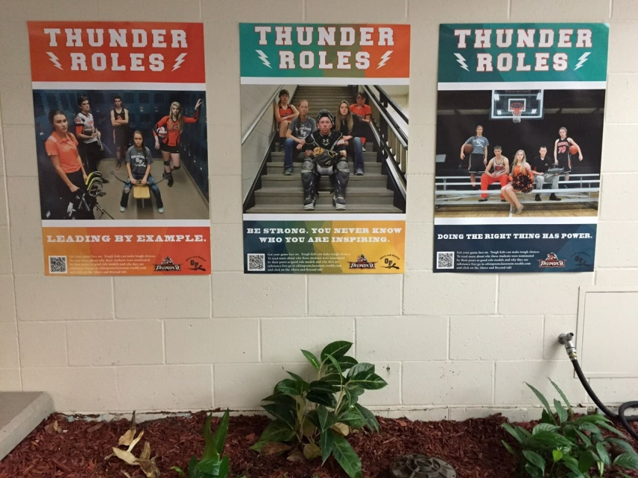
‘Thunder Roles’ Posters
Students selected for the posters are nominated by their peers as good role models (the list is then sent to staff for input)
In 2015 we did 3 separate posters (one for each sport season)
In 2016 we did a sport poster and an activities poster because the students felt that the activities (clubs) were being over shadowed by the sports
Printed standard posters and enlarged posters for display by the gymnasium

Slide 16
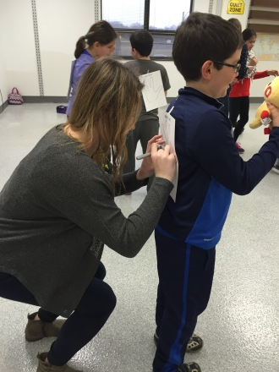
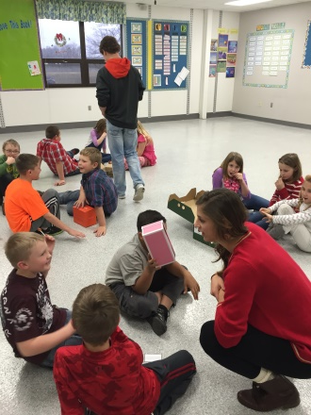
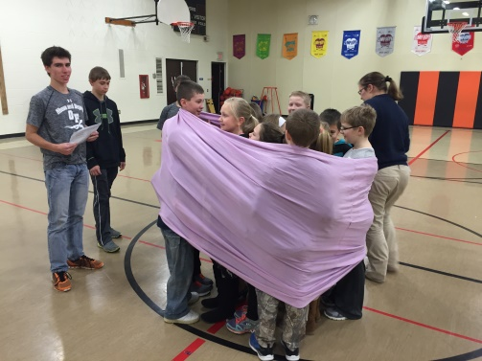
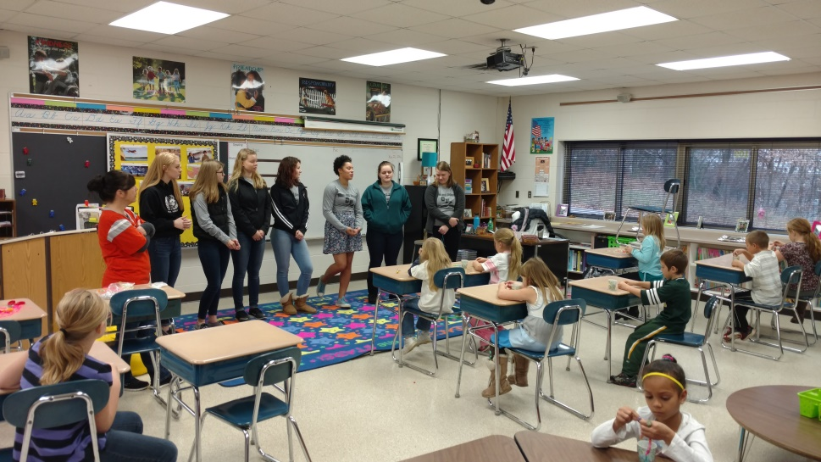
Interaction With Elementary Schools
Osseo Elementary 2015 ‘Character Building Day’
Osseo Elementary 2016 ‘PBIS Assembly’ Speaking
Fairchild Elementary 2016 ‘PBIS Loyalty Assembly’ Speaking and Activities

Slide 17
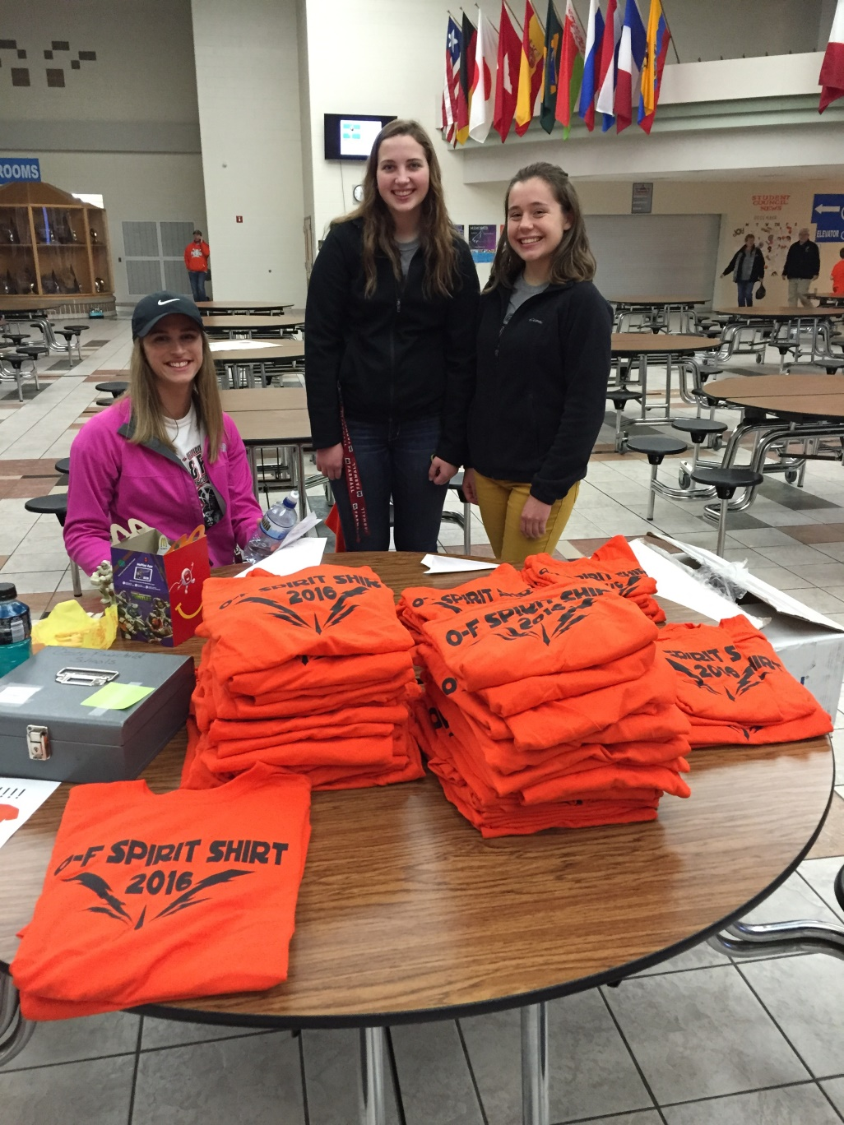
Spirit Shirts
Students Pay $5 for a spirit shirt that will get that student into all regular season home events for free as a way to emphasize school related activities as healthy and substance free activities (also where AODA information is available)

Slide 18
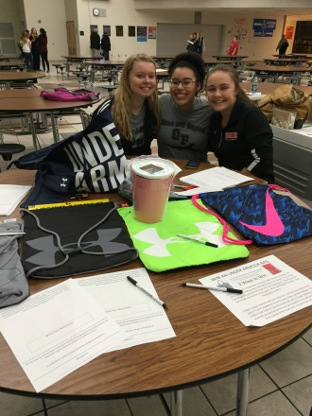
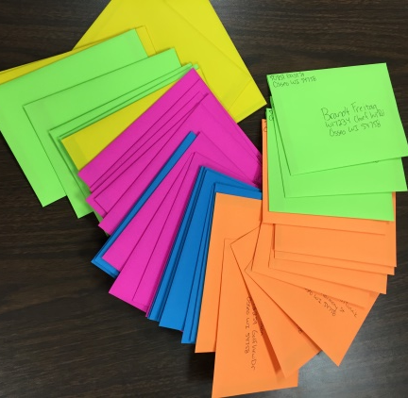
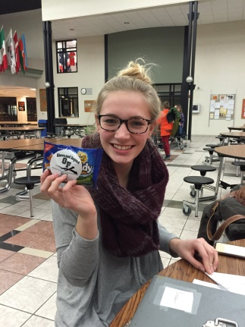
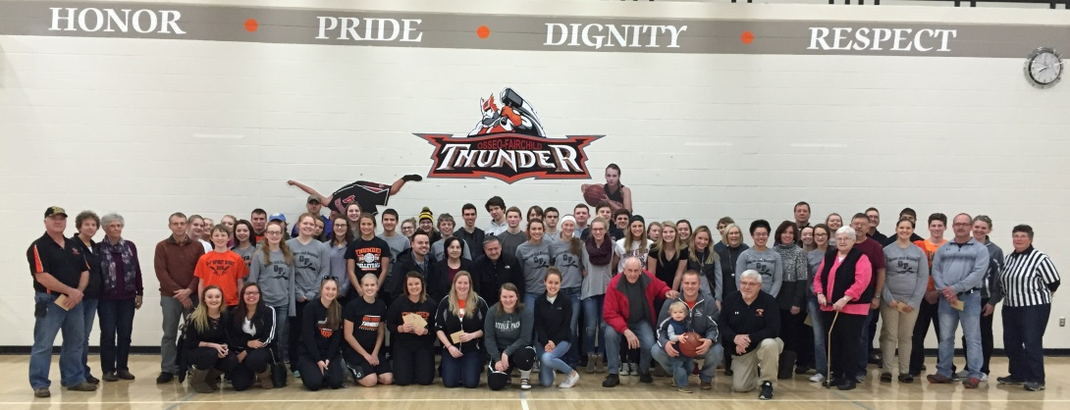
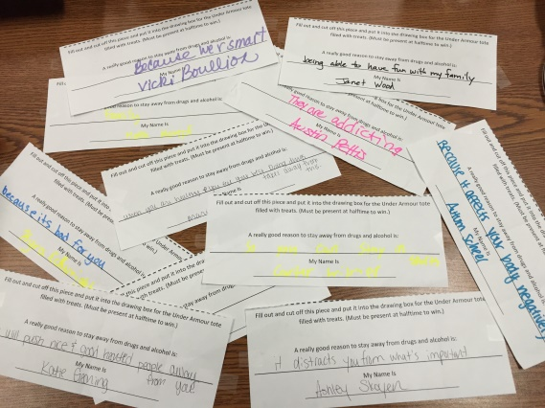
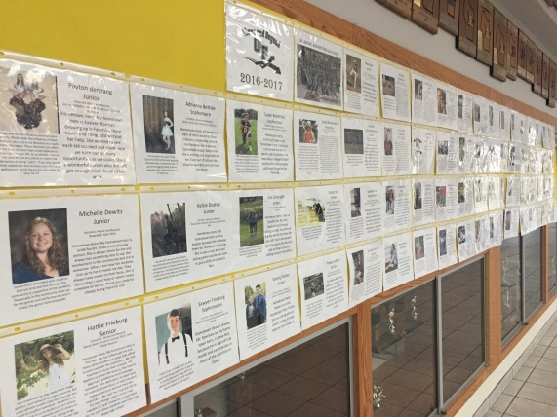
AODA Event Nights
In 2015 we had an AODA Event night where students got in free to games and we had highlights about the Above and Beyond group and AODA information available (367 students at the football game, 80 at the volleyball game and an average of 125 at the basketball games – we also did wrestling but it was a free admission event already)
​In 2016 we chose to do the first event nights at 2 basketball games (one girls game and one boys game)
Hometown Heroes Recognized
Giveaways
Above and Beyond Wall
Popcorn Bags with AB Stickers
Treats with AB Stickers
Announcement at Halftime

Slide 19
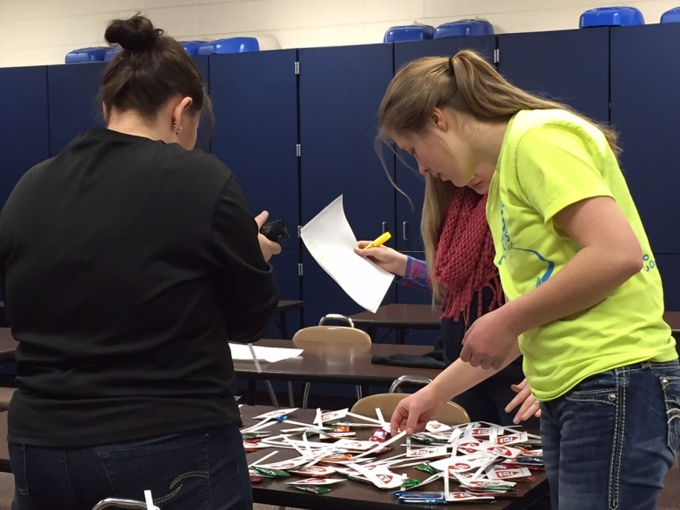
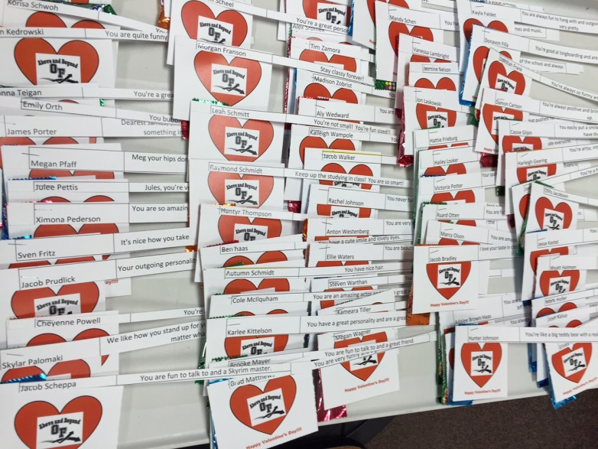
High School Valentines
Above and Beyond students made valentines for each high school students
Valentines included a label with the website logo and QR code, a personal message of why the students adds to our community in a positive way, and a treat

Slide 20
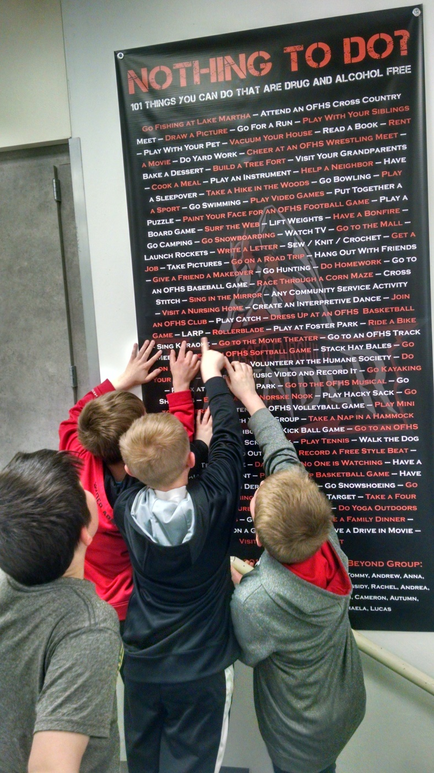
101 Things Banners
Above and Beyond members created a list of 101 things that can be done in Osseo or Fairchild that are healthy and substance free
Vinyl banners were created to display at Fairchild Elementary, Osseo Elementary and the Middle / High School

Slide 21
Upcoming
MS Lunch Interaction
We noticed that in 2015 we did not have any activities specifically for middle school students
Lunch with an Above and Beyond Member

